Slide 1

AUDIO AUGMENTED REALITY
Look At The Sky
Laura M. Henry
2467245H

Slide 2

MOTIVATION
Motivation
Augmented Reality is a typically visual technology that layers additional, computer-generated information over a user’s field of view.
Audio augmented reality (Audio AR) instead uses sound to communicate this information to the user, thereby freeing up their field of view.
This project aimed to explore a new application of audio-augmented reality for use on standard hardware in a general, everyday usage context.

Slide 3
PROJECT OVERVIEW
Project Overview
The final product is an app for Android devices named Look At The Sky. This is an audio augmented reality weather app that plays a 3D sound effect to represent the current or forecast weather.
The app utilises head gesture control as its main interaction method in order to free up as much of the user’s visual attention as possible.
The app runs on the Bose AR platform and was tested using the Bose Frames and NC700 Headphones.
The user can perform a Look Up gesture to hear an immersive 3D sound effect representing the current weather. This effect plays for as long as the user remains looking up.
The user can perform an input gesture to toggle the forecast mode, where the current and forecast weather are represented as sounds positioned in a ring around the user’s head. Each position represents one hour of time.

Slide 4
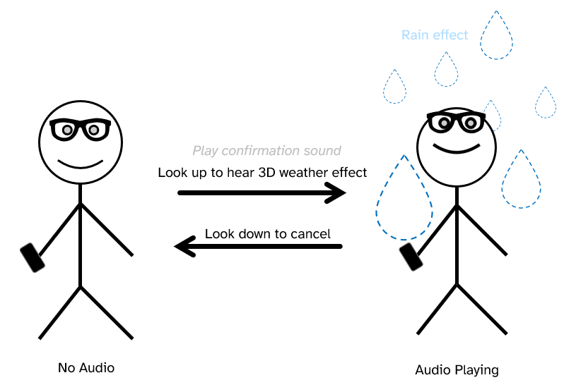
PROJECT OVERVIEW
Project Overview
Illustration of the current weather function:

Slide 5
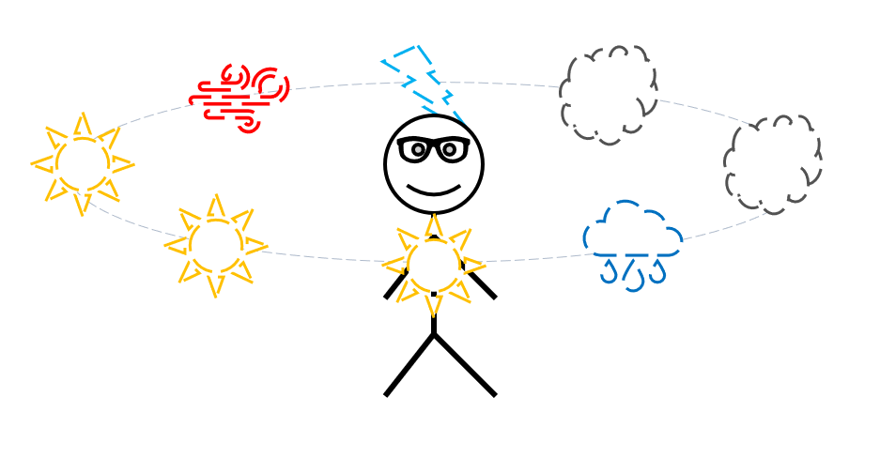
PROJECT OVERVIEW
Project Overview
Illustration of the forecast function:

Slide 6
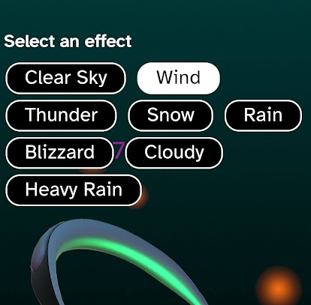
PROJECT OVERVIEW
Project Overview
Eight weather conditions are included in the final design:
Clear Sky
Wind
Thunder
Snow
Rain
Blizzard
Cloudy
Heavy Rain

Slide 7
EVALUATION - STRUCTURE
Evaluation
Evaluation was carried out in three stages:
An initial questionnaire to evaluate the effectiveness of eight weather effect sounds on their own (without their accompanying visuals).
Feedback from this evaluation was used to improve the sounds in later iterations.
A main evaluation consisting of a think-aloud evaluation and accompanying questionnaire.
Each participant used both the Bose Frames and NC700 headphones.
A smaller, final evaluation of the same format to check that the gesture detection script had been corrected when using the NC700 headphones.

Slide 8
EVALUATION - AUDIO
Evaluation
The results of both the initial survey and main evaluation suggest that more intense weather conditions that already have a natural association with sound are more intuitive when translated to pure audio.
When using the forecast mode, users had more difficulty in determining where a specific sound was coming from when there were more sounds being played at once. Many preferred to display the minimum amount of sounds in this mode.

Slide 9
EVALUATION - GESTURES
Evaluation
A major issue discovered during the main evaluation was the point at which the look up gesture activated.
When using the Bose Frames, 8 of the 11 participants found that the gesture triggered at a comfortable angle for their neck, while only 1 found this to be the case while using the headphones.
To remedy this, the gesture detection script was adjusted to dynamically set different trigger points depending on which of the two headsets is connected to the app.
The effectiveness of this update was investigated in the final evaluation and does appear to have resolved the issue, though ideally this evaluation would have used all of the same participants as the main experiment.

Slide 10
FUTURE WORK
Future Work
With further time and refinement, this app could reasonably be made suitable for wider use.
There are several weather conditions absent from the final iteration including hail, sleet and variations of existing effects such as a stronger wind.
The app would benefit from becoming more platform-agnostic as the Bose AR platform is no longer officially supported.
There is potential to further extend the functionality of the app using audio AR, for example by playing subtle audio notifications if rain (or any other weather condition, as defined by the user) is forecast.

